Slide 1
D6780 Grant Qualification & Management Seminar
TITLE
Fall 2023
For the 2024-2025 Rotary Year

Slide 2
GOAL FOR TODAY
Understand District Grant Basics:
Timeline Qualifying Your Club
Funding Creating a Project
Management Applying for a District Grant
Stewardship Implementing Your Project
Notes:
Qualification
Timeline
Application
Conducting a grant

Slide 3
AGENDA
OVERVIEW Bobby
CLUB QUALIFICATION David & Linda
CREATING A PROJECT David
APPLYING FOR A DISTRICT GRANT Pat
PROJECT IMPLEMENTATION Pat & David

Slide 4
OVERVIEW
Bobby Davis
District Rotary Foundation Chair

Slide 5
24-25 DISTRICT GRANT TIMELINE
PE and Club identify project in 2023
Club becomes qualified to submit a district grant
Applications accepted Oct. 7, 2023, to Jan. 31, 2024
Applications reviewed & approved beginning 02.01.24

Slide 6
24-25 DISTRICT GRANT TIMELINE
5. All DG applications are bundled and submitted to The Rotary Foundation for approval – target date 05.24
TRF approves the bundled district grants & clubs are notified they may begin their project – target date 06.24
Project implementation

Slide 7
24-25 DISTRICT GRANT TIMELINE
8. Progress report due midway through the project and no later than October 1, 2024
9. Final report due by May 31, 2025, including receipts for all expenditures
10. District disburses funds after approval of final report

Slide 8
GRANT BASICS
Must be humanitarian but NOT limited to The Rotary Foundation’s seven (7) areas of focus
May be local or international
Funded by donations to the Annual Fund by D6780 Rotarians 3 years prior
For 24-25, donations from the 21-22 Rotary year fund District Grants

Slide 9

Rotary’s Seven Areas of Focus

Slide 10
2024- 2025 Funding
Annual Fund Donations 2021-22 = $765,499
47.5%
SHARE
47.5%
District Controlled
Trustees Controlled
$363,612
$363,612
District Designated Fund
World
Fund
Other
(Cash, DAF, Endowment Fund)
50% (min)
$181,806
$181,806
District Grants
Global Grants
(World Fund match
to DDF and Other
50% (max)

Slide 11
Grant Management
Ensures that your grant:
Has proper financial controls in place
Is guided by humanitarian & educational principles
Meets the needs of the beneficiaries
Fulfills objectives based on a community assessment
Safeguards donor funds

Slide 12
Stewardship
Responsible Management & Oversight of Funds:
  Rotarian supervision
  Standard business practices
  Irregularities reported to TRF
  Projects implemented as approved
  Financial records reviewed
  Reports submitted in a timely fashion

Slide 13
CLUB QUALIFICATION
Linda Shults
District Grants Forms Coordinator
David Carroll
District Grants Chair

Slide 14
CLUB MOU & QUALIFICATION FORMS
Display Club Memorandum of Understanding and Club Qualification Form

Slide 15
Qualification Requirements
At least two (2) club members attend the district Rotary Foundation Grant Management Seminar
Club agrees with Club Memorandum of Understanding (MOU)
Club submits Club MOU & Qualification Plan
District Approves Club Qualification Plan

Slide 16
Club Requalification
Required annually
Review last year’s Qualification Plan
    Do you understand what was written?
    Did you do what you wrote?
    Was it good enough?
Modify & resubmit Qualification Plan
Sign new Memorandum of Understanding (MOU)

Slide 17
Maintaining Qualification
Follow the terms of the Club MOU
Fully implement stewardship and grant management practices to prevent misuse of funds
Appoint a club member or committee to manage club qualification

Slide 18
Club Qualification Plan
What MOU requirements does your club already implement?
What requirements does your club need to implement?
What type of club members would be good choices to help implement the Club MOU?

Slide 19
Best Practices/Issues
Manager
Conflicts of Interest
Training
Bank Account
Financial Management Plan
Document Retention
Reports
Misuse Plan
Approval

Slide 20
Overview & Club Qualification
Questions?

Slide 21
CREATING A PROJECT
David Carroll

Slide 22
Objectives
Identify best practices for choosing a project
Develop a plan to implement your project
Understand what is needed to establish a financial management plan

Slide 23
Successful Grant Projects
Meet real community needs
Have frequent personal partner communication
Have implementation plans with measurable goals and outcomes
Are sustainable beyond the life of the grant
Practice proper stewardship of grant funds

Slide 24
Community Assessment
Talk with partners and members of the community
Assess your club’s resources and availability and its potential partners to meet the need
Choose a project that is based on what the community needs, not what you want to do!

Slide 25
Partners
How can partners help you make your project more successful?
How do you identify potential partners?
  Other Rotary clubs in your community?
  Other non-profits or NGOs or government organizations?

Slide 26
Project Planning
Form a 3-person grant committee
Assign roles
Set measurable and sustainable goals
Create a budget
Create an implementation plan
Have a contingency plan

Slide 27
Creating a Budget
Realistic
Competitive bidding
Reasonable prices
Disclose potential or real conflicts of interest

Slide 28
Creating a Project
Questions?

Slide 29
APPLYING FOR A DISTRICT GRANT
Pat White
District Grant Coordinator

Slide 30
Learning Objectives
Be able to write a successful grant proposal and application
Understand good stewardship practices

Slide 31
District Grants Forms
Forms can be found on the District 6780 Website
(rotarydistrict6780.com):
  Instructions
  Timeline
  District Grant Checklist
  Club Qual and MOU
  Single Club Application
  Multi-Club Application
  District Grant Progress Report Template
  District Grant Final Report Template

Slide 32
DISTRICT GRANT APPLICATION FORM
Display Single Club District Grant Application Form

Slide 33
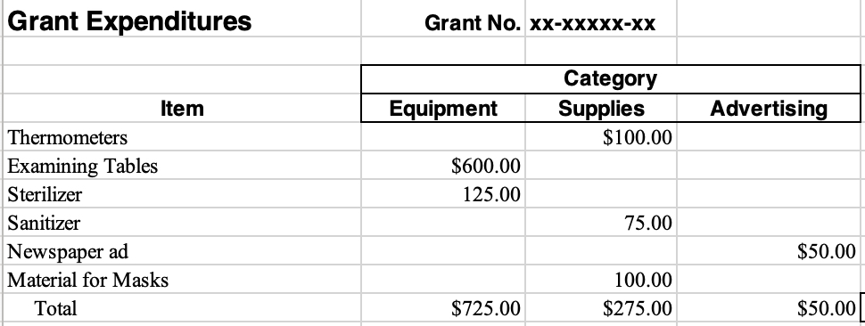
SAMPLE BUDGET

Slide 34
DISTRICT GRANT CHECKLIST
Are all District Grant & Global Grant reports up to date?
Is your club grant qualified for 24-25?
    Two club members attended DG qualification training
    Club Qualification & Club Memorandum of Understanding have been completed and sent to Pat White and David Carroll

Slide 35
DISTRICT GRANT CHECKLIST
Has someone else read the grant application for completeness?
Does the timeline match the District Grant timeline?
Do you describe how those in need will be helped?
Is there Rotarian involvement?

Slide 36
DISTRICT GRANT CHECKLIST
How can the benefits be sustained?
Has a project chair been selected & contact info provided?
Is your budget detailed and included?
Do all expenses meet grant restrictions?
Are all partners listed? Do their contributions match budget?

Slide 37
DISTRICT GRANT CHECKLIST
Is the application signed by the President or PE? Does the PE understand his or her responsibilities?
Are letters of support from cooperating partners included?
Have all documents been copied before submitting to DG committee?

Slide 38
APPLYING FOR A DISTRICT GRANT
Questions?

Slide 39
IMPLEMENTATION AND REPORTING
David Carroll
District Grants Coordinator
Pat White
District Grant Coordinator
Notes:
.

Slide 40
Objectives
Understand how to monitor the progress of your plan
Identify best practices for managing funds and record keeping
Discuss the importance of evaluating a project and applying the lessons learned
Understand the reporting requirements

Slide 41
Successful Project Implementation
Personal Contact
Communication
Financial Management
Record Keeping
Follow the Original Plan (or Update)

Slide 42
Evaluation
Ongoing during project implementation and project completion
Based on goals set for the project
Assists with reporting requirements
Use the findings to improve future projects and identify successes you can promote!

Slide 43
District Grant Reports
Progress report is due October 1, 2024
Target date for grant completion: March 31, 2025
A final report (including receipts) is due within 2 months of project completion or by May 31, 2025 (whichever comes first)
The final report must be approved by the District Grant Team before the District pays its share of grant funding

Slide 44
District Grant Progress Report Sections
  Project Description
  Rotarian Participation
    How many?
    What have they done?
  Project Status
    What has been completed?
    What is left to complete?
    On schedule for completion?

Slide 45
District Grant Progress Report Sections
  Funding to Date
  Expenditures to Date
  Amount of District Grant Funds Expected to Be Requested
  Certification

Slide 46
District Grant Final Report Sections
  Project Description
  Rotarian Participation
    How many?
    What have they done?
  Project Impacts
    How many non-Rotarians benefited?
    Expected long term benefits?
    Role of any cooperating organization?

Slide 47
District Grant Final Report Sections
  Funding
  Expenditures
  Amount of District Grant Funds Requested
  Certification
Receipts sorted and labeled by budget category
MUST be attached to the final report!

Slide 48
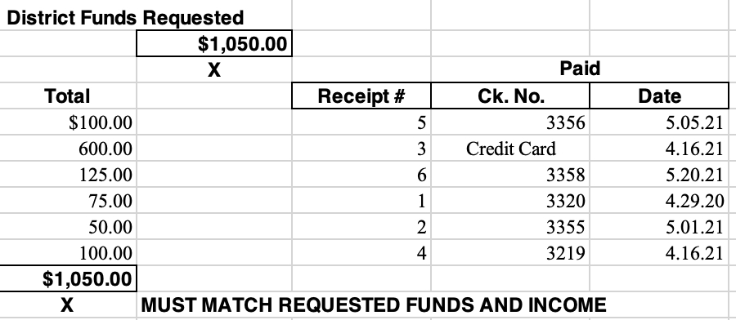
DISTRICT FUNDS REQUESTED

Slide 49
Implementation and Reporting
Questions?

Slide 50
How Did It Go?

Slide 51
DISTRICT 6780 DISTRICT GRANT CONTACTS
David Carroll, District Grants Chair
Cell: 423.595.3503 dcarroll1960@aol.com
Pat White, 23-24 District Grant Coordinator
Cell: 865.236.2072 pkmsw@aol.com

Slide 52
Thank You!

